Slide 1
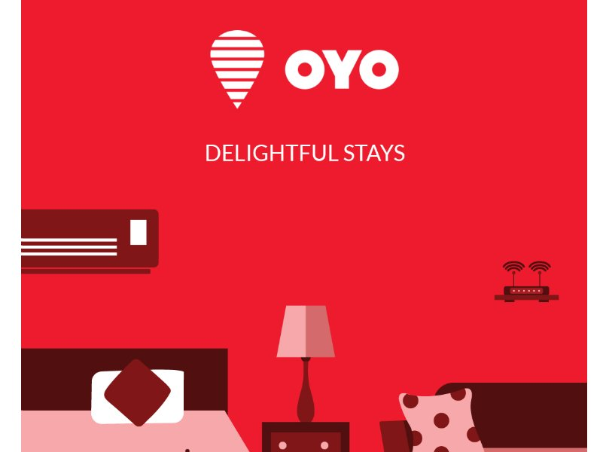

Slide 2
Overview
Ritesh Agarwal, 21yrs old is the owner of OYO rooms.
OYO Rooms, commonly known as OYO, is an Indian hospitality service and budget hotel network.
It was founded as Oravel Stays Pvt. Ltd in 2012 and later changed to OYO rooms in 2013
OYO Rooms owns and operates a chain of budget hotels and allowing guests to book accommodations via mobile application.
OYO Rooms has 3,650 employees
OYO Rooms main competitors are Treebo, Stayzilla and FabHotels

Slide 3
Introduction
OYO Rooms headquarters is in Gurgaon, Haryana.
It has over 8,500 hotels in 230 cities in India, Malaysia, Nepal, China and Indonesia.
Oyo is now adding 10,000 rooms or close to 500 hotels every month under its franchise model.
It currently has around 60,000 rooms under the fully managed franchise model, and another 10,000 rooms under the earlier aggregator model.
Oyo (Oravel Stays Pvt. Ltd) is now generating more than 90% of its revenue from hotels that it has leased from owners.
OYO Rooms has raised a total of $697.3M in funding.

Slide 4
Oyo Segments
OYO Rooms-flagship budget brand(999-1500)
OYO Premium rooms(1500-3000)
OYO Homes(like Airbnb)
Studio Stays by OYO(cities)

Slide 5
Business Model
Oyo Rooms Business Model is an aggregator model. The services are brought by the users under the name of Oyo.
Books a part of Hotel’s inventory beforehand.
Organizes those hotel rooms under their brand name – Oyo Rooms
These partner hotels provide standardized service to customers of those rooms as decided in a contract with Oyo
Bookings are made through the Oyo Rooms website and mobile application.

Slide 6
Functional Departments in OYO
Product Development(Technology): 100+ Engineers building new technologies every day.
Branding & Communications: Brand through online and offline media.
Business Development(Sales): Property Identification , contractual formalities.
City operations: Account reconciliation, property maintenance, handling escalations.
Reservations and customer experience: Dedicated in house call centre.
owner engagement
Finance: Invoices, payments and reconciliation.

Slide 7
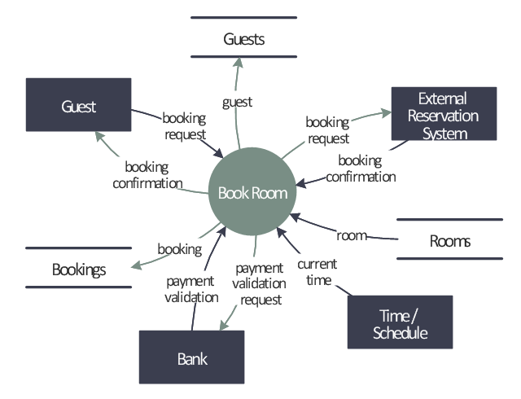
Room Booking Process

Slide 8
COST
Inventory of properties Cost 67.5 crore per month
Employees
Ad campaign-20 to 100 crore
Google online ads - 1 to 2 crore
Photography expenses
REVENUE
10-20% (commission) margin
Room Rental Charges
Advertising Charges

Slide 9
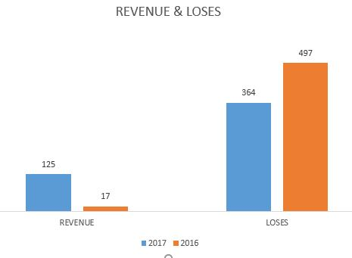
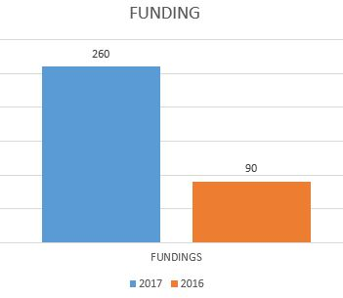
FINANCIALS
MARKET VALUATION
US$1 billion
(CRORES)
(Million Dollars)

Slide 10
Metrics
Average daily realised rooms nights
Net Take Rate
NPS score- No. of people who give us a rating of 5/5 –No. of people who give us a rating of 1/5 or 2/5
Total Available Rooms
Market Penetration Index (MPI) or Occupancy Penetration Index
MCPB (marketing cost per booking)
Website/App conversion rate
TrevPar-total revenue per available room

Slide 11
Analytics and Software
Krypton – an internal audit app to audit the hotels properties and it also captures customer feedback.
Orbis, a BI tool used by the Sales workforce to understand the demand patterns in the area and offers they should be making to different partner hotels.
Dynamic Room Pricing
Understanding Customer Behaviour
Traffic analysis tools: Google analytic, Mouse flow, New Relic

